Slide 1

B.M.S. College of Engineering M.Tech AAT Presentation On Implementing E-commerce CRUD Operations and wallmarts data analysis M SNEHA (1BM22SCS06) PRAJWAL D (1BM22SCS08) SARA SUMAIYYA (1BM22SCS10) SHWETHA H (1BM22SCS13) Second Semester, M.Tech Department of CSE, BMSCE
Internal Guide
Dr. Pallavi G B
Assistant Professor
Department of CSE, BMSCE
2022-23

Slide 2
TABLE OF CONTENTS
Objectives
Project Design
Queries
Results

Slide 3
Aim Of The Project
The aim of this e-commerce website is to develop a robust online retail platform with advanced capabilities, including CRUD operations for product and user management, along with data analysis and predictive features.
The primary objectives are as follows:
User Management: Implement user registration, authentication, and profile management functionalities. Users should be able to create accounts, log in securely, and update their profiles.
Product Management (CRUD): Create, Read, Update, and Delete (CRUD) operations for managing products. Admin users can add new products, modify existing ones, remove products, and view product details.

Slide 4
Order Processing: Enable users to browse products, add items to their shopping carts, place orders, and view order history. Admins can manage and fulfill orders.
Wishlist and Favorites: Allow users to create wishlists, add products to them, and view or purchase items later. Implement features like product recommendations and favorites.
Predictive Analytics: Utilize machine learning and predictive modeling to make product recommendations based on user preferences and historical data. Implement features like personalized product recommendations and upselling/cross-selling suggestions.

Slide 5
CRUD OPERATIONS
Within computer programming, the acronym CRUD stands for create, read, update, and delete. These are the four basic functions of persistent storage.
Create (C)
Purpose: Create new documents (records) in a MongoDB collection.
MongoDB Method: Use the insertOne() or insertMany() method to add one or multiple documents, respectively, to a collection.
Example: Inserting a new user document into a "Users" collection.

Slide 6
Retrieve (R)
Purpose: Retrieve and view documents from a MongoDB collection.
MongoDB Method: Use the find() method to query and retrieve documents from a collection. You can apply filters and projection to tailor the results.
Example: Fetching all user documents or finding users with a specific attribute.

Slide 7
Update (U)
Purpose: Modify and update existing documents in a MongoDB collection.
MongoDB Method: Use the updateOne() or updateMany() method to modify one or multiple documents, respectively, in a collection.
Example: Updating a user's profile information or modifying multiple product documents.

Slide 8
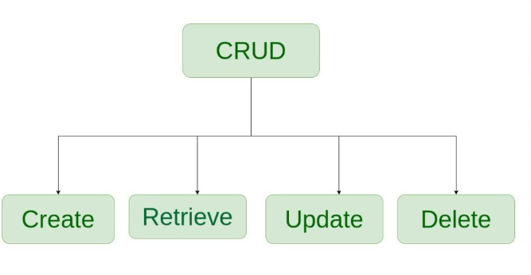
Figure: CRUD Operations

Slide 9
Delete (D)
Purpose: Remove documents from a MongoDB collection.
MongoDB Method: Use the deleteOne() or deleteMany() method to remove one or multiple documents, respectively, from a collection.
Example: Deleting a user account or removing outdated records from a log collection.

Slide 10
Register User (POST /register)
This operation is used to create a new user account.
It then creates a new user record in the database.
const { name, email, password } = req.body;
const user = await User.create({
name,
email,
password,
avatar: {
public_id: myCloud.public_id,
url: myCloud.secure_url,
},
});
This code takes user registration data (name, email, password) and stores it in the MongoDB database as a new user document.

Slide 11
Read (R) - Login User
// Retrieving a user document from MongoDB based on their email.
const user = await User.findOne({ email }).select("+password");
This code fetches a user document from the MongoDB "User" collection by their email address to perform a login operation.
Update (U) - Update User Profile
// Updating a user's profile information in the MongoDB "User" collection.
const user = await User.findByIdAndUpdate(req.user.id, newUserData, {
new: true,
runValidators: true,
useFindAndModify: false,
});
This code modifies a user's profile information (name and email) in the MongoDB database based on their user ID.

Slide 12
Delete (D) - Delete User // Deleting a user document from the MongoDB "User" collection. await user.remove(); This code removes a user document from the MongoDB "User" collection, effectively deleting the user's account.

Slide 13
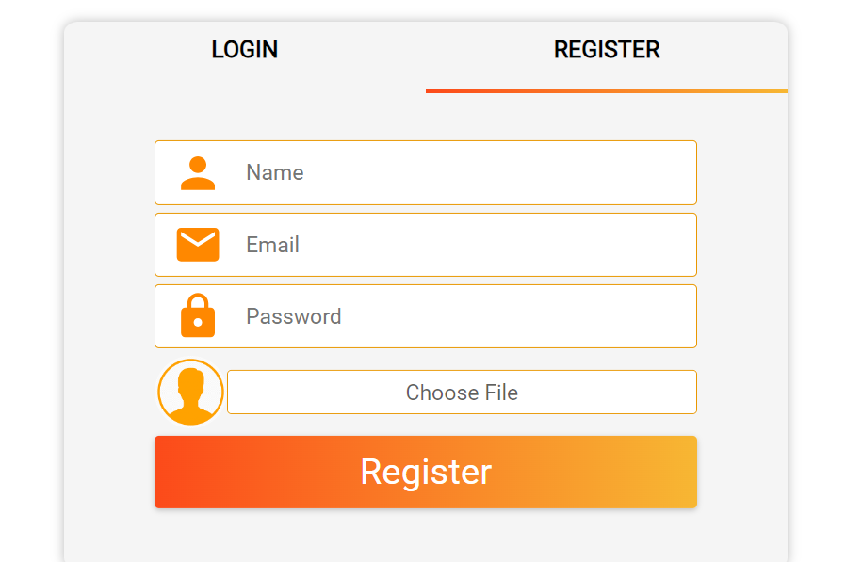
Figure: Create/Register user

Slide 14
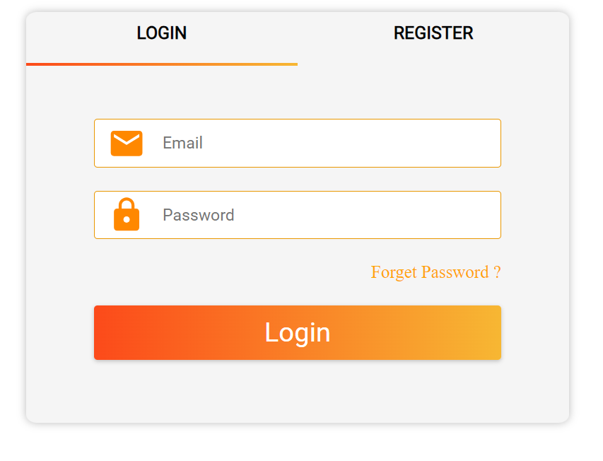
Figure: Login user

Slide 15
Product Controller
// Uploading product images to Cloudinary and storing their links in the "images" field of the product document.
const product = await Product.create(req.body);
This code creates a new product in the MongoDB "Product" collection by uploading images to Cloudinary and storing their links in the product document.
Read (R) - Get All Products
// Fetching all products from the MongoDB "Product" collection with pagination and filtering options.
const apiFeature = new APiFeatures(Product.find(), req.query)
.search()
.filter();
let products = await apiFeature.query;

Slide 16
This code retrieves all products from the MongoDB "Product" collection while allowing pagination and filtering based on query parameters. Update (U) - Update Product // Updating a product in the MongoDB "Product" collection, including handling image updates. product = await Product.findByIdAndUpdate(req.params.id, req.body, { new: true, runValidators: true, useFindAndModify: false, }); This code updates an existing product in the MongoDB "Product" collection, including the possibility of updating product images.

Slide 17
Delete (D) - Delete Product // Deleting a product from the MongoDB "Product" collection and removing associated images from Cloudinary. await product.remove(); This code removes a product document from the MongoDB "Product" collection and also deletes associated images from Cloudinary. Create (C) - Create Product Review // Adding a product review to an existing product in the MongoDB "Product" collection. const product = await Product.findById(productId); This code allows users to create or update a product review, adding it to an existing product in the MongoDB "Product" collection.

Slide 18
Delete (D) - Delete Review // Deleting a review from a product in the MongoDB "Product" collection and updating the product's ratings and review count. await Product.findByIdAndUpdate( req.query.productId, { reviews, ratings, numOfReviews, }, { new: true, runValidators: true, useFindAndModify: false, } ); This code removes a review from a product in the MongoDB "Product" collection and updates the product's ratings and review count accordingly.

Slide 19
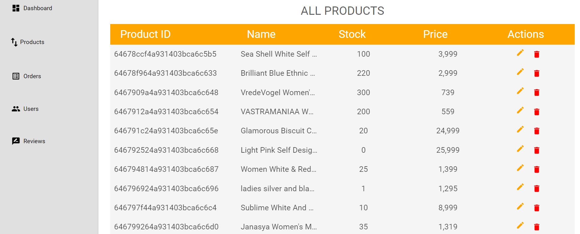
Figure: Update and Delete of Product

Slide 20
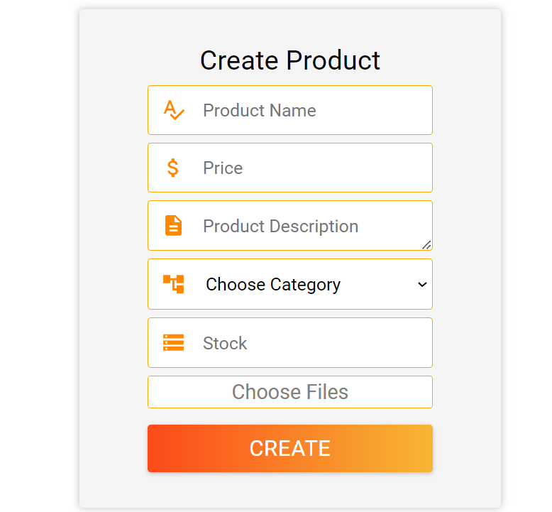
Figure: Create Product

Slide 21
Create (C) - Create New Order // Create a new order document in the MongoDB "Order" collection. const order = await Order.create({ shippingInfo, orderItems, paymentInfo, itemsPrice, taxPrice, shippingPrice, totalPrice, paidAt: Date.now(), user: req.user._id, }); This code creates a new order in the MongoDB "Order" collection, recording details like shipping information, order items, payment information, and more.
CRUD operations involved in ordering the products

Slide 22
Read (R) - Get Single Order Details // Retrieve a single order by its unique ID from the MongoDB "Order" collection. const order = await Order.findById(req.params.id).populate("user", "name email"); This code fetches the details of a single order from the MongoDB "Order" collection, and it also populates the user information associated with that order. Read (R) - Get Orders Details or My Order Details (Access by Only Logged-In User) // Retrieve all orders for the currently logged-in user from the MongoDB "Order" collection. const orders = await Order.find({ user: req.user._id }); This code fetches all orders associated with the currently logged-in user from the MongoDB "Order" collection.

Slide 23
Update (U) - Update Order Status (Admin Only) // Retrieve all orders from the MongoDB "Order" collection, available only to admin users. const orders = await Order.find(); let totalAmount = 0; orders.forEach((order) => { totalAmount += order.totalPrice; }); This code allows an admin user to update the status of an order in the MongoDB "Order" collection. It also handles stock updates when an order is marked as "Shipped."

Slide 24
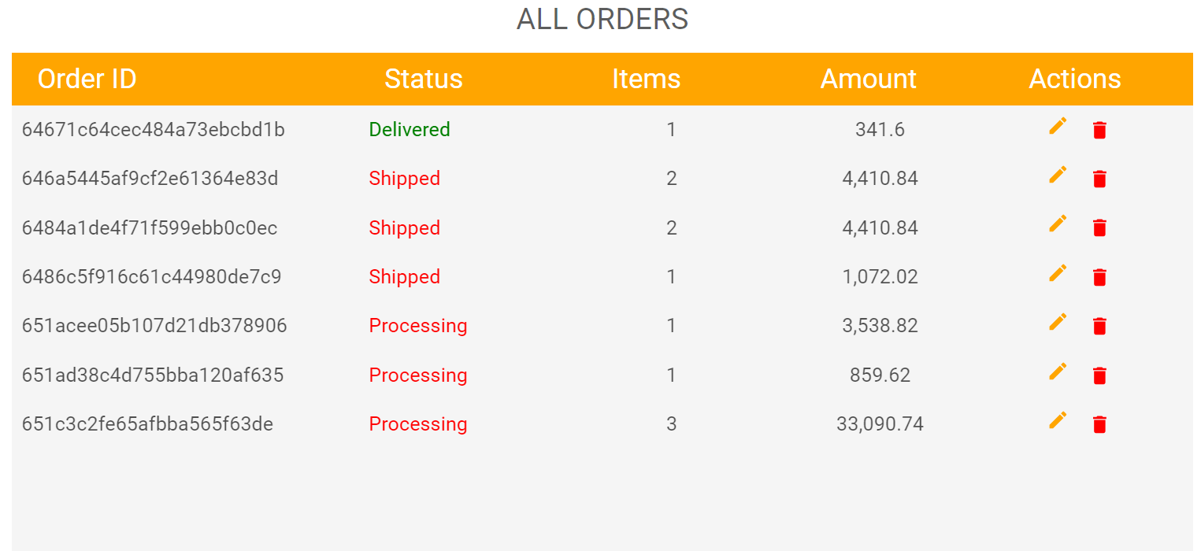
Figure: Update and Delete order

Slide 25
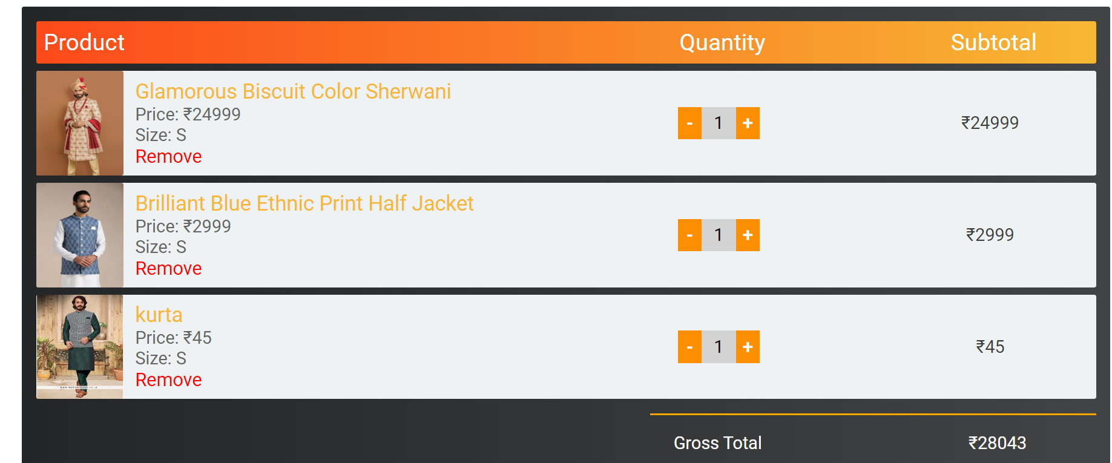
Figure: Create Order

Slide 26
CRUD Operations for whishlist
Create (C) - Add to Wishlist
// Check if a wishlist exists for the user. If it exists, add a new product to the wishlist; otherwise, create a new wishlist.
const { user, orderItems } = req.body;
const Finduser = await Wishlist.find({ user: user });
if (Finduser.length !== 0) {
const product = await Wishlist.find({ user: user });
function f(data) {
return data.product == orderItems[0].product;
}
if (product[0].orderItems.filter(f).length > 0) {
return next(new ErrorHandler("Product already added in Wishlist", 404));

Slide 27
} else { await Wishlist.updateOne( { user: user }, { $push: { orderItems: [orderItems[0]], }, } ); } } else { const wishlist = await Wishlist.create(req.body); }

Slide 28
This code handles the addition of products to a user's wishlist. It first checks if a wishlist exists for the user. If it does, it checks if the product is already in the wishlist. If not, it adds the product to the existing wishlist. If no wishlist exists for the user, a new wishlist is created. Delete (D) - Remove Wishlist Data // Remove a specific product from the user's wishlist. const { user, product } = req.body; const users = await Wishlist.updateOne( { user: user }, { $pull: { orderItems: { product: product }, }, } );

Slide 29
const users = await Wishlist.updateOne( { user: user }, { $pull: { orderItems: { product: product }, }, } ); This code allows the removal of a specific product from the user's wishlist. It updates the wishlist by removing the specified product.

Slide 30
Read (R) - Get Wishlist Data // Retrieve the wishlist data for a specific user, including the details of products in the wishlist. const wishlist = await Wishlist.findOne({ user: req.params.id }).populate( "orderItems.product" ); This code retrieves the wishlist data for a specific user from the MongoDB "Wishlist" collection. It also populates the product details for each item in the wishlist, allowing you to fetch product information along with the wishlist. These CRUD operations for managing a user's wishlist help you create, read, update, and delete items in the wishlist, providing a seamless user experience for tracking desired products.

Slide 31
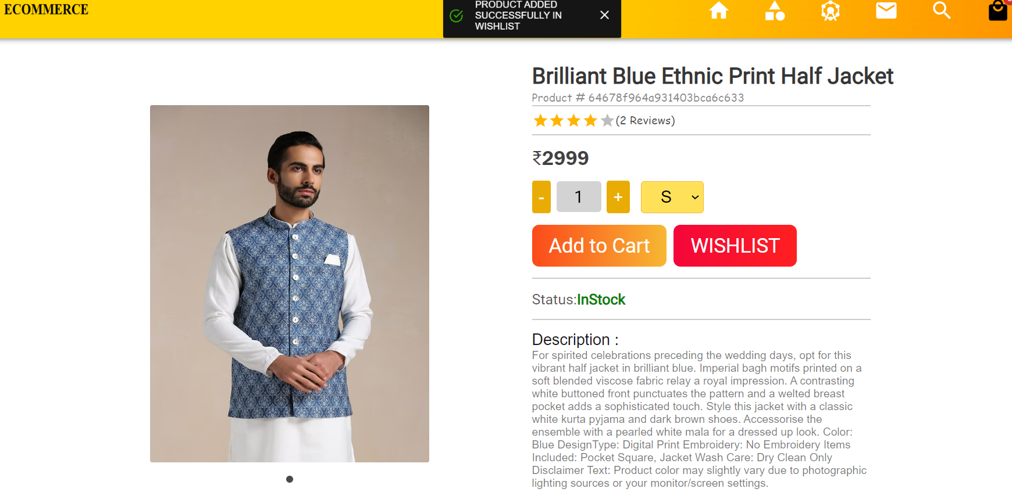
Figure: update Whishlist

Slide 32
Prediction For wallmart Dataset
import matplotlib.pyplot as plt
# Sample data
data = [51, 39, 10]
stores = ['Store A', 'Store B', 'Store C']
# Creating plot
fig, ax = plt.subplots()
plt.pie(data, labels=stores, autopct='%.0f%%')
ax.set_title('Which Type of stores has more sales')
# Show plot
plt.show()

Slide 33
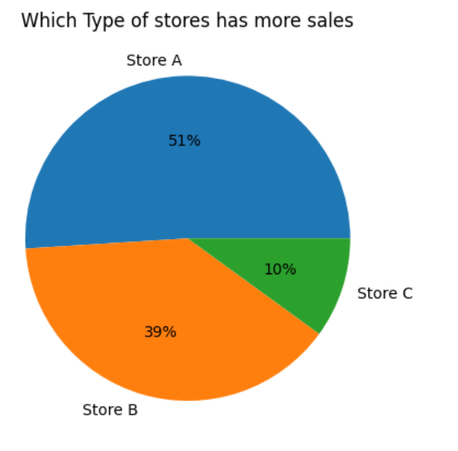
Figure: Percerntage of sales each store containing

Slide 34
Plotting Correlation Heatmap
# import modules
import matplotlib.pyplot as mp
import pandas as pd
import seaborn as sns
# import file with data
data = traindf4
# prints data that will be plotted

Slide 35
# columns shown here are selected by corr() since
# they are ideal for the plot
print(data.corr())
sns.set_theme(style="whitegrid")
# plotting correlation heatmap
dataplot = sns.heatmap(data.corr(), cmap="YlGnBu", annot=True)
sns.set(rc = {'figure.figsize':(25,8)})
# displaying heatmap
mp.show()

Slide 36
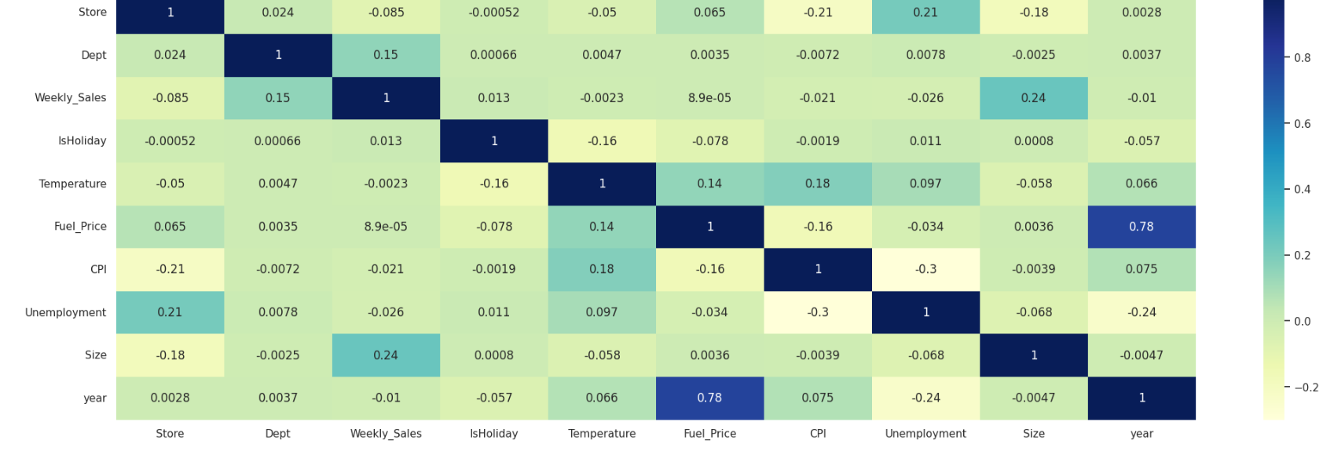
Figure: Plotting correlation heatmap

Slide 37
Weekly Sales
import seaborn as sns
sns.set_theme(style="whitegrid")
tips = traindf4
ax = sns.barplot(x='Store', y="Weekly_Sales", data=tips)

Slide 38
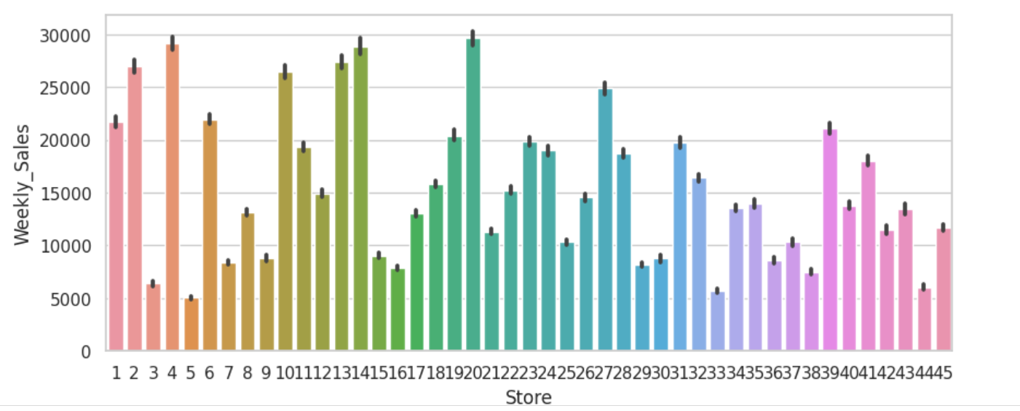
Figure: Weekly sales

Slide 39
Weekly Sales corresponding to Department
# importing required packages
import seaborn as sns
import matplotlib.pyplot as plt
# loading dataset
data =traindf4
# draw pointplot
sns.pointplot(x ='Dept',
y = "Weekly_Sales",data = data)
# show the plot
sns.set(rc = {'figure.figsize':(25,8)})
plt.show()

Slide 40
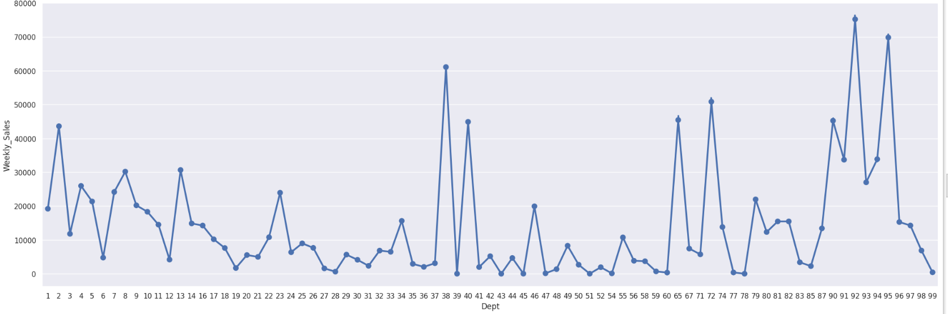
Figure: Weekly Sales for corresponding department

Slide 41
Monthly Sales
traindf5=traindf4.drop(['Date'],axis=1)
month_wise_sales = pd.pivot_table(traindf5, values = "Weekly_Sales", columns = "year", index = "month")
month_wise_sales.plot()

Slide 42
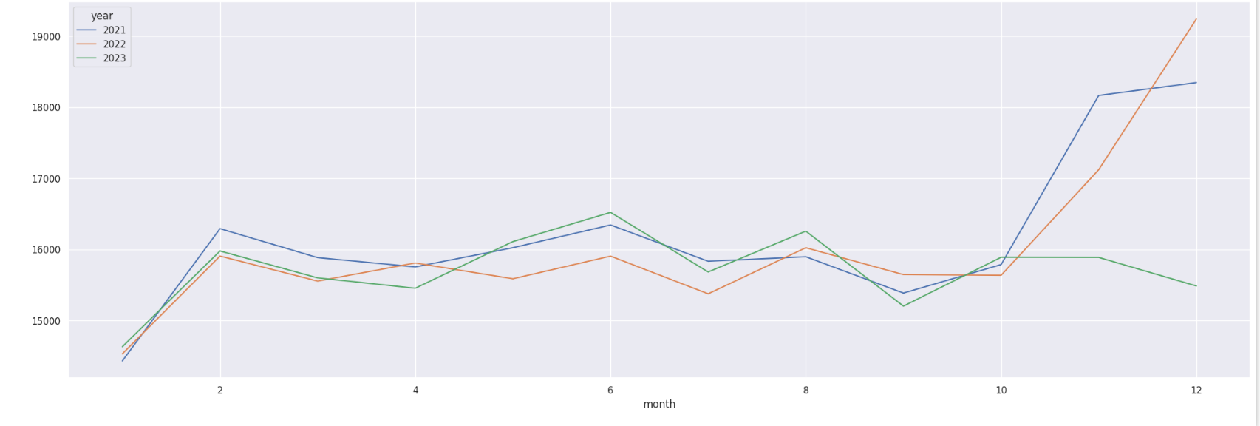
Figure : Monthly sales

Slide 43
Results
With the help of the following prediction we are able to predict the weekly sales of the store along with the department.
We are also able to make the decisisons on the factor affecting the sales.
The following analysis helps us to know which regression algorith best suits for accurate prediction.
The anlysis is done to know which month has the maximum sales and which month has the least sales.

Slide 44


